Slide 1

Playwright Selectors

Slide 2
Agenda
1: What is Microsoft Playwright?
2: Why Playwright?
3: Playwright Architecture
4: Inspector Playwright & codegen
5: Playwright Selectors
6: Reference documentation

Slide 3
1: What is Microsoft Playwright?
Newer, open-source, cross-browser automation library for end-to-end testing.
Is a Node.js library to automate Chromium, Firefox, Webkit with a single API
Is headless by default
Support programming languages (javascript, C#, Java, Python)

Slide 4
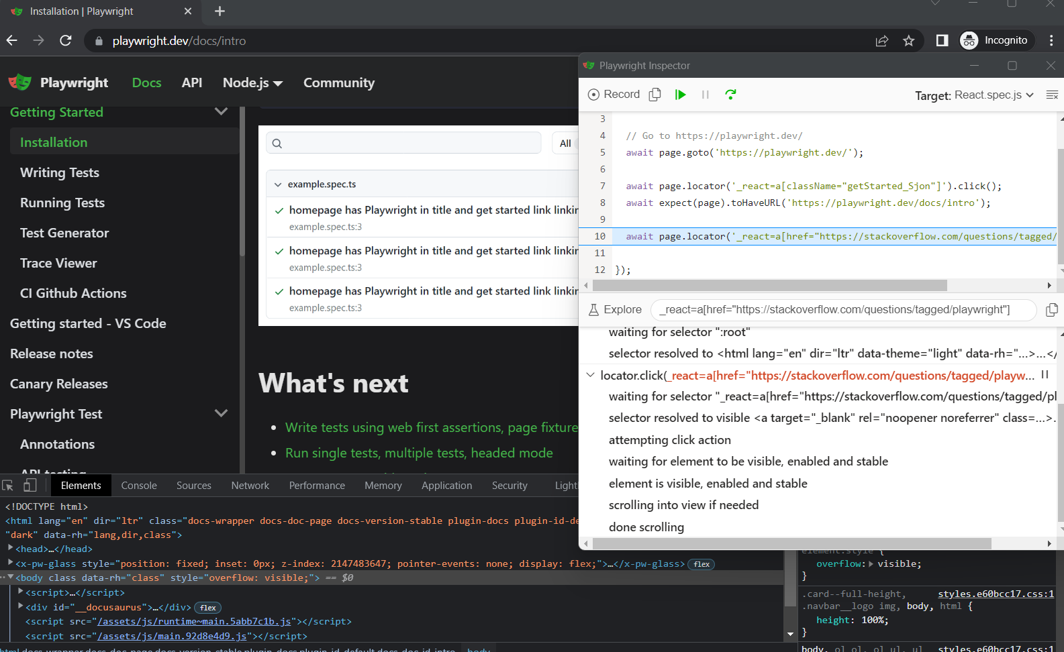
2: Pros of Playwright
1: Use websocket protocol > tests just need start as a logged-in user only one time> save time, faster
2: Built and maintained by Microsoft > be reliable
3: Fastest test execution time
Refer doc: Puppeteer vs Selenium vs Playwright, a speed comparison | Checkly blog (checklyhq.com)
4: Auto-wait (as image attached)
5: Support multi- selectors (ex: shadow DOM, chaining,...)
6: Smart assertions > retry until an element is found, data tracing.(as image)

Slide 5
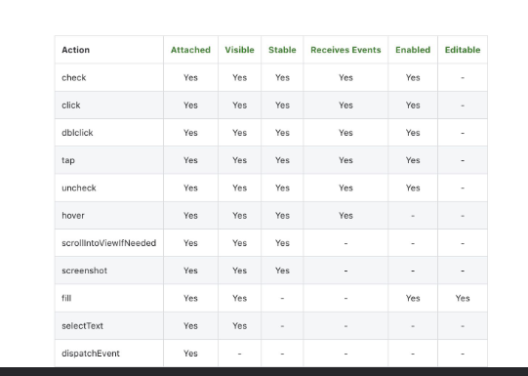
2: Pros of Playwright (cont.)
7: Parallel test execution > save time
8: Test Runner > easy to use
9: VS Code extension has features to run tests with a single click, debug step by step, explore selectors,
and record new tests (codegen) > easy to use
10: Emulation for mobile devices
11: Supports testing scenarios for Cross browser, multi-language & open-source

Slide 6
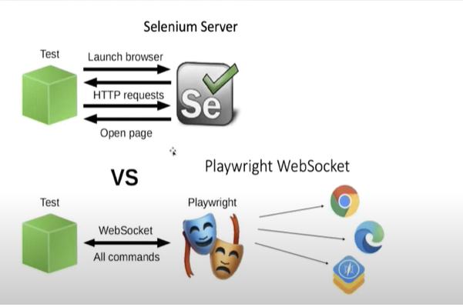
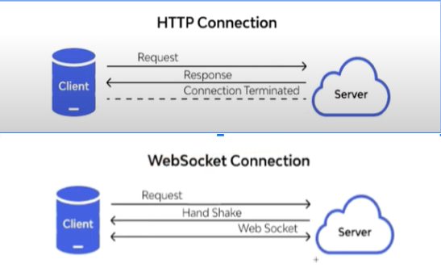
3: Playwright Architecture

Slide 7
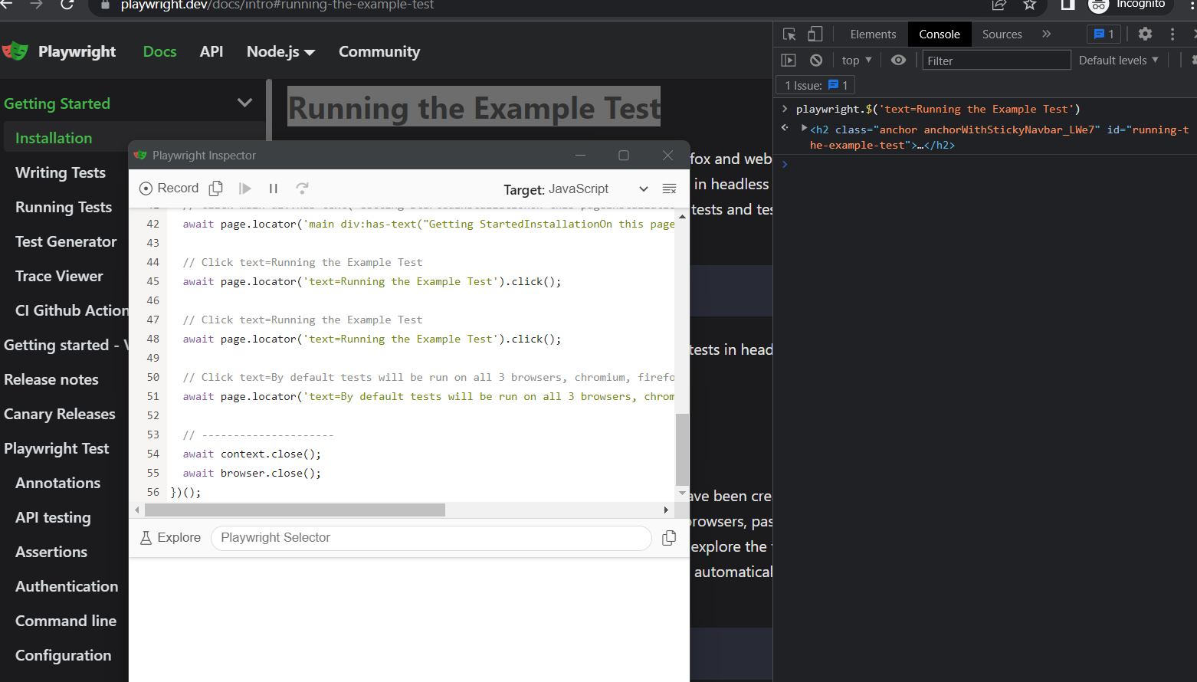
4: Inspector Playwright & codegen
Playwright Inspector
Using DevTools
Easy to find locator
Easy to debug
Codegen
Created new test with playwright code generation

Slide 8
5: Playwright Selectors
Include:
1: Text
2: CSS
3: Xpath
4: Selecting elements matching one of the conditions
5: Selecting elements in Shadow DOM
6: selecting elements based on layout
7: Selecting visible elements
8: N-th element
9: React
10: Chaining
11: Best practices and to avoid choose selectors

Slide 9
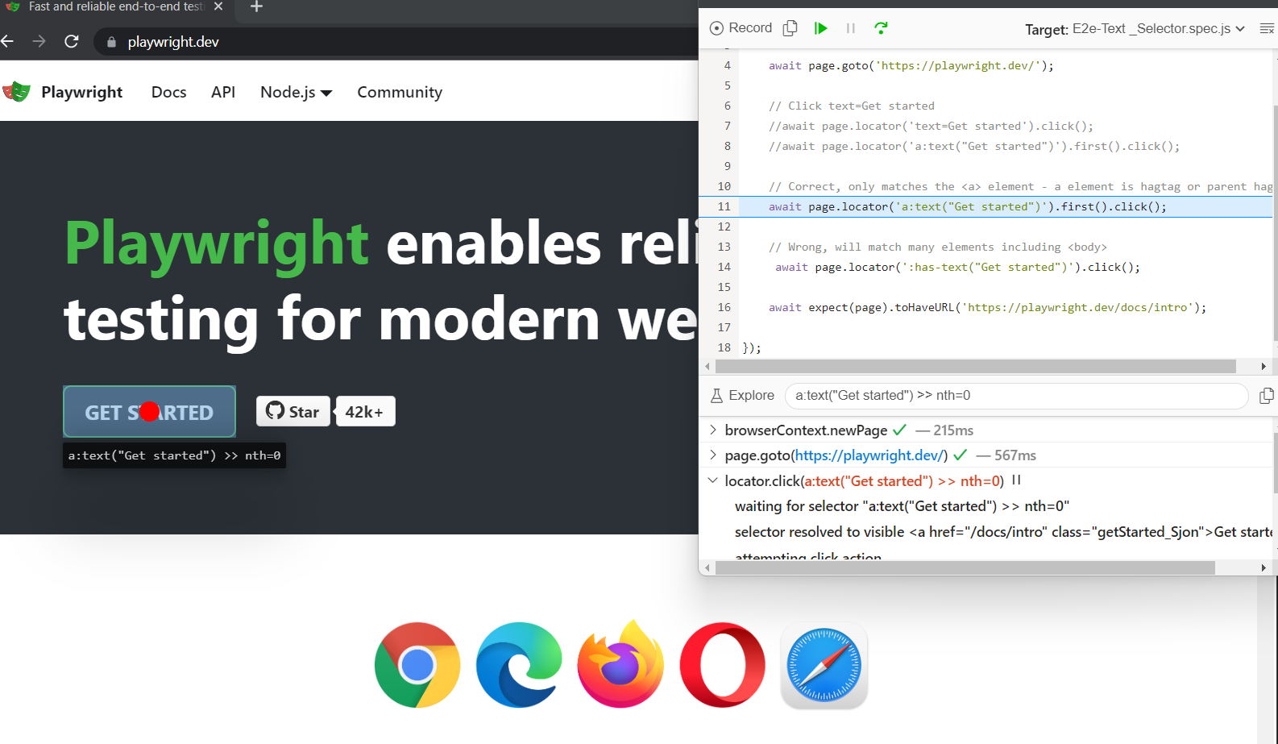
5.1 - Text
Text selector locates elements that contain passed text.
Syntax: await page.locator('text=Get started’').click();
Or await page.locator('a:has-text("Get started")').click();
or await page.locator('a:text("Get started")').click();

Slide 10
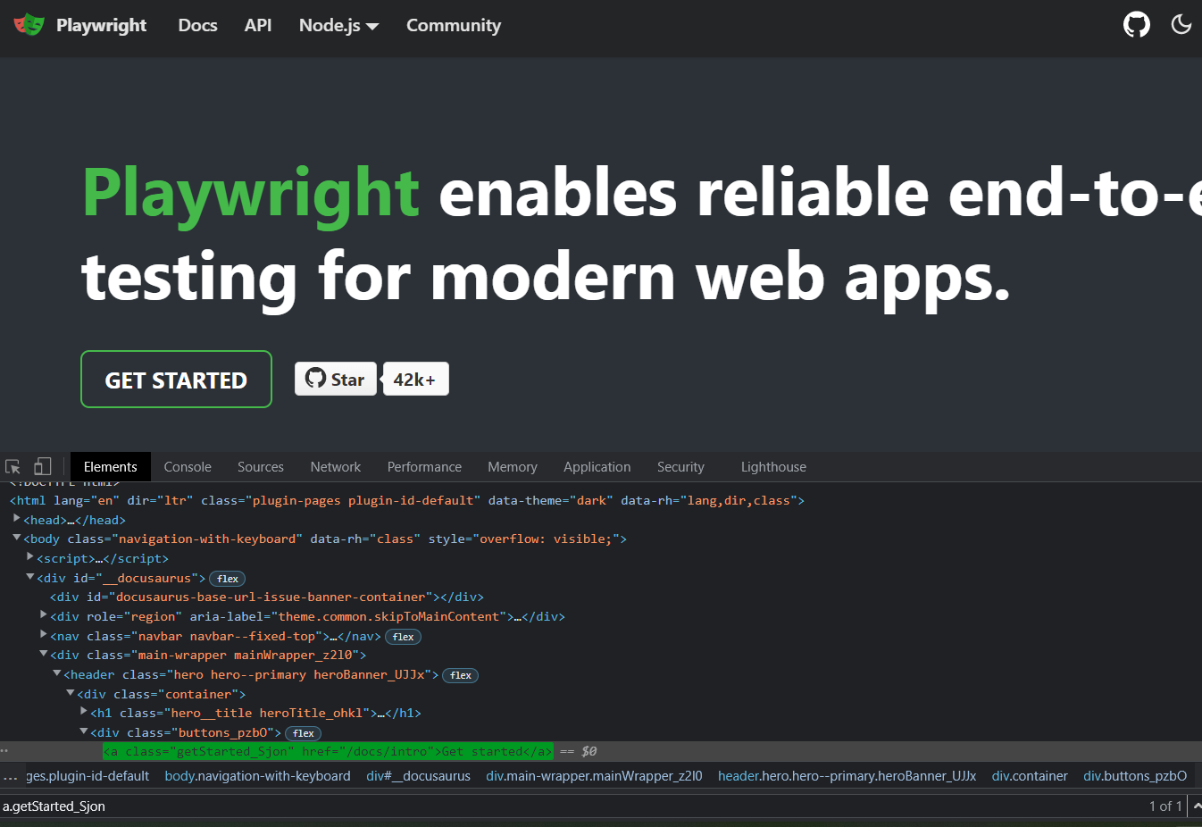
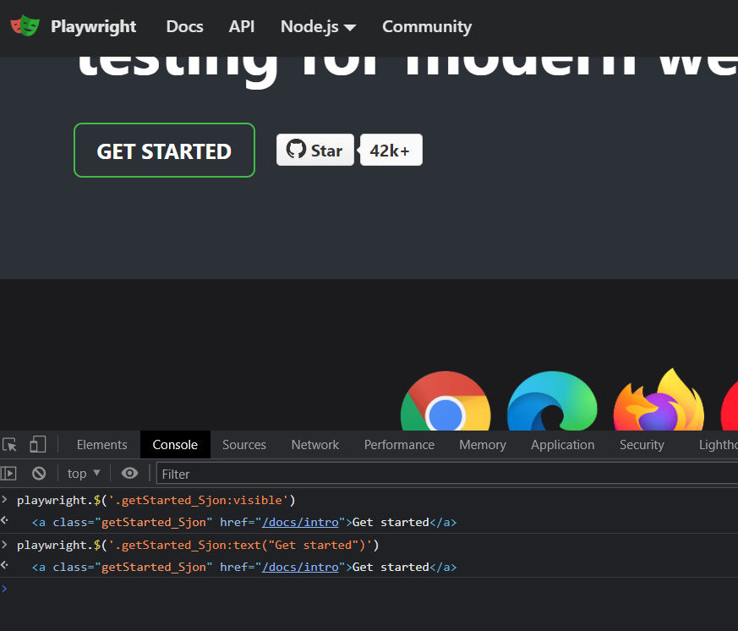
5.2 - CSS
Advanced
Playwright add custom pseudo-classes like
:visible
:text
Default
Select by element tag type
EX- CSS Syntax: .class

Slide 11
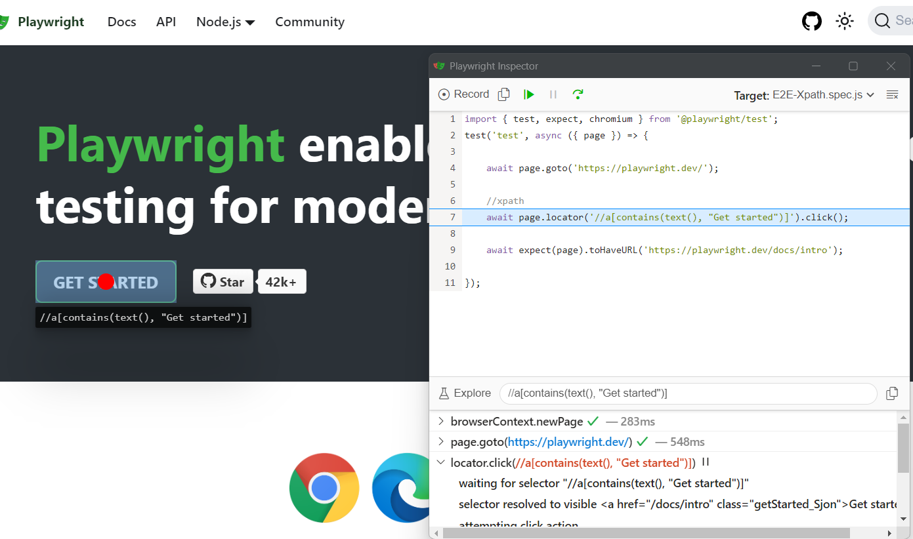
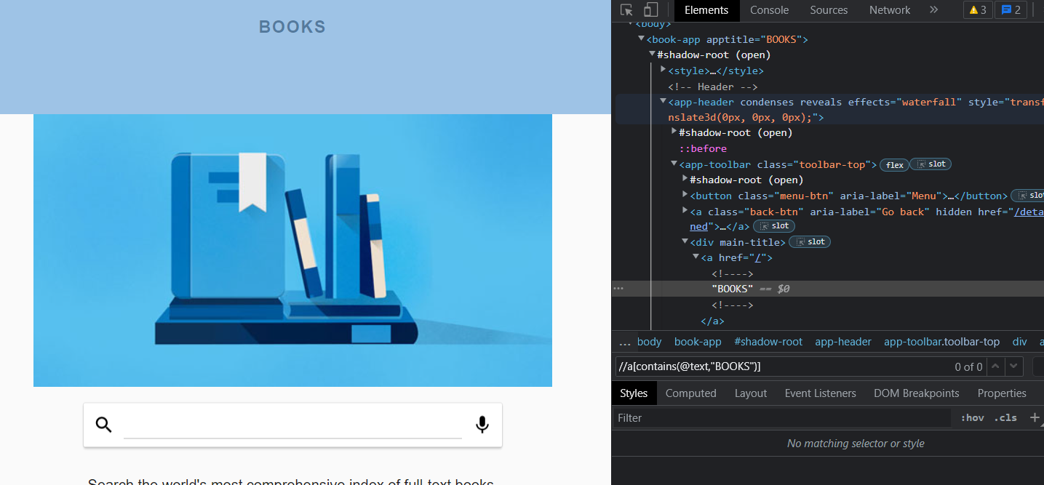
5.3 - xpath
Syntax: xpath=//html/body
xpath does not pierce shadow roots

Slide 12
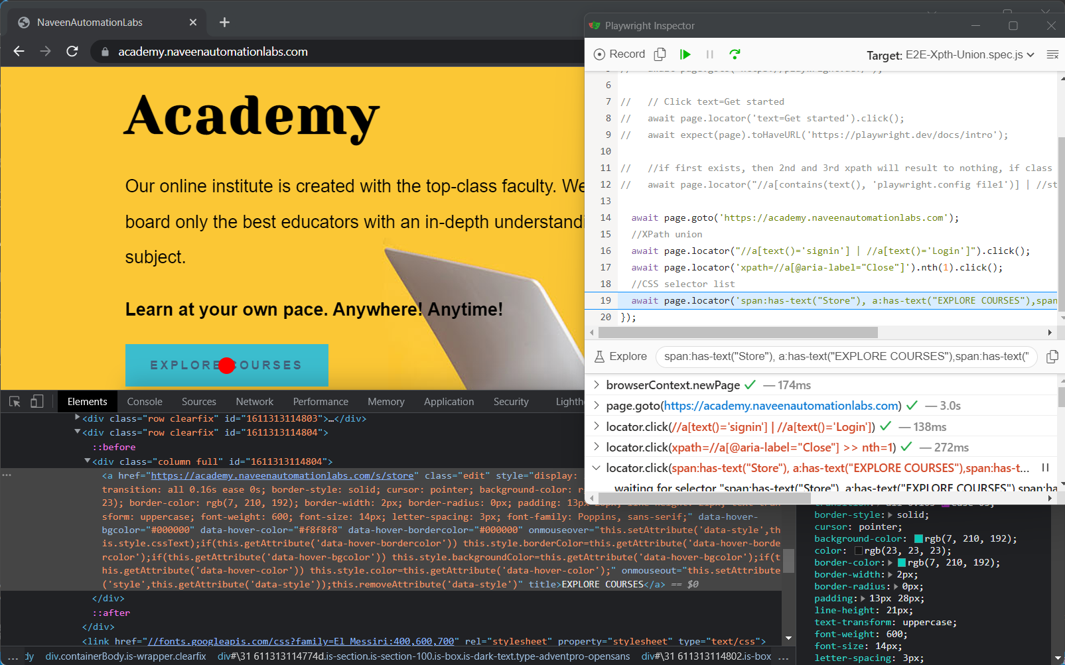
5.4 - Selecting elements matching one of the conditions
CSS selector list
Comma-separated list of CSS selectors will match all elements that can be selected by one of the selectors in that list.
XPath union
| used to specify multiple selectors in XPath. It will match all elements that can be selected by one of the selectors in that list.

Slide 13
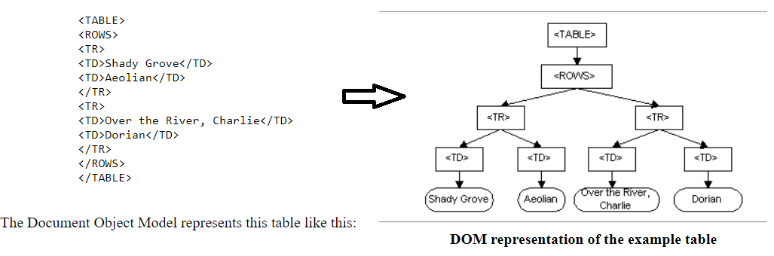
5.5 - DOM
What is DOM (Document Object Model)?
Determines what content should be on a page
How each element of the content relates to the other elements
Document | . Way to structure information (articles, books,...) . Web page = document
Object | . The “stuff” in a document (include Content, Structural elements,Attributes)
Model | . Representation of something . Helps us understand how something is put together

Slide 14
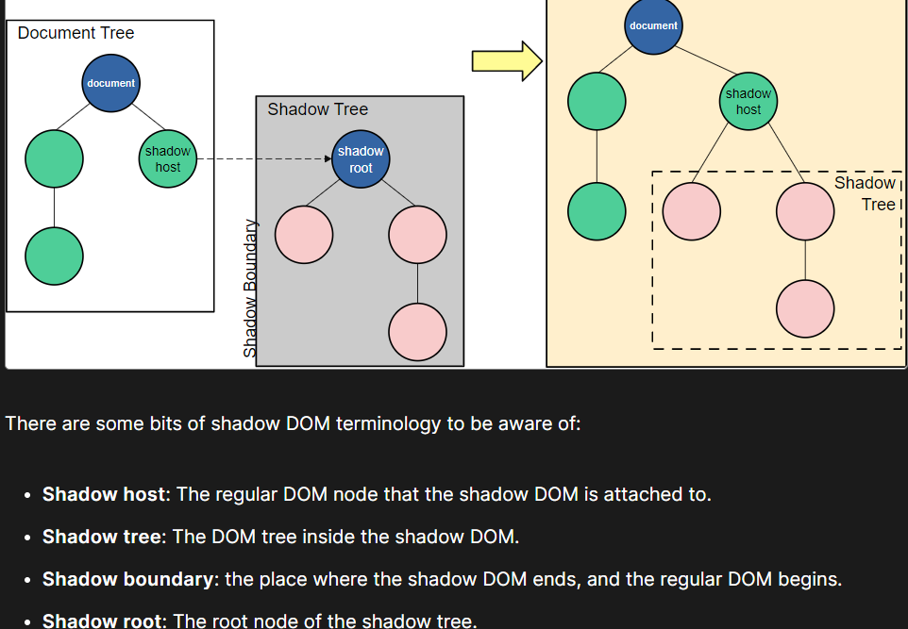
5.5 - shadow DOM (cont.)
What is shadow DOM ?
Web API that provides a way to attach a hidden DOM to a DOM element
Isolated DOM
A “lite” version of the DOM
Need third-party scripts to display things without it messing with your pre-existing elements
Notes:
What Is the Shadow DOM and Why Does It Matter in JavaScript? (dottedsquirrel.com)

Slide 15
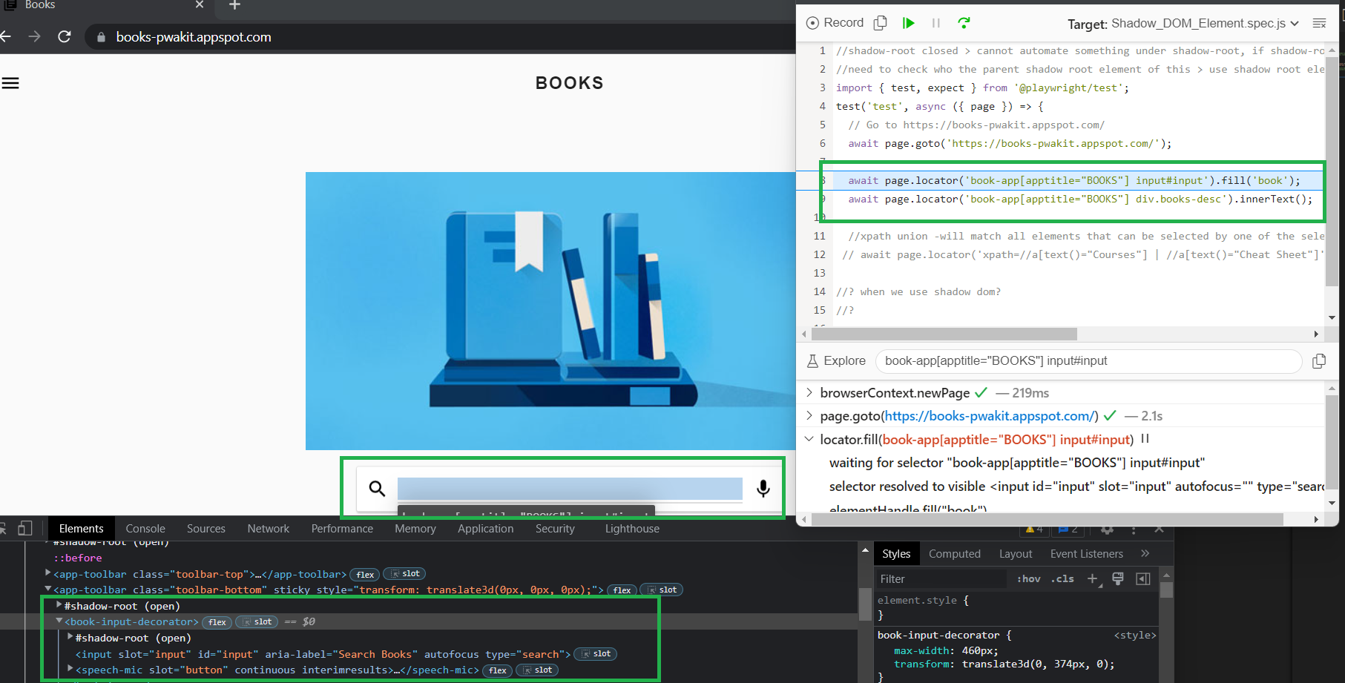
5.5 - shadow DOM (cont.)
Cannot use normal Locators to catch shadow DOM element except playwright
We are directly accessing our element using page.locator(‘#input’) when using shadow DOM

Slide 16
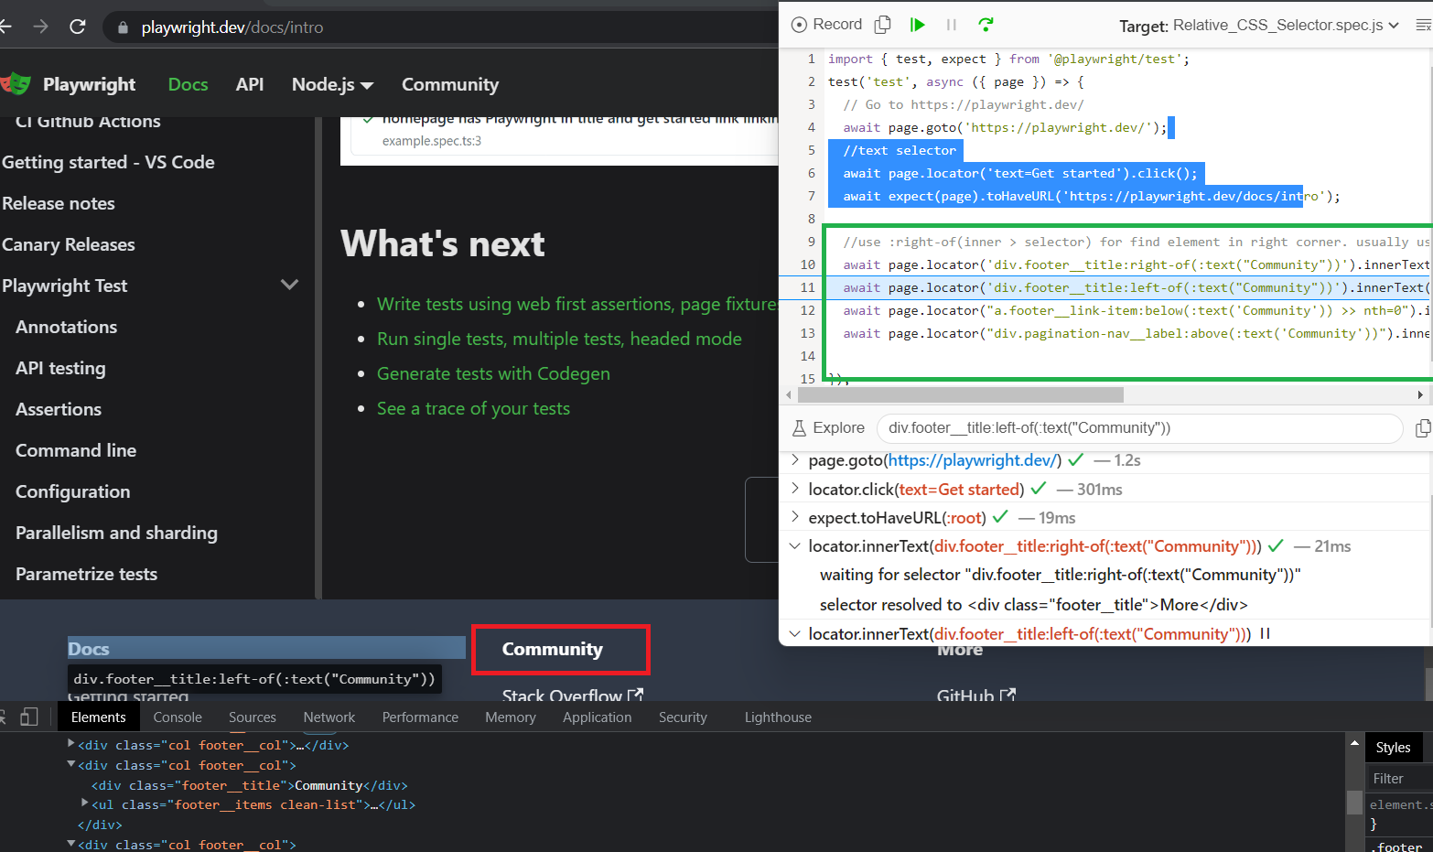
5.6 - Relative Selector
It is hard to come up with a good selector to the target element when it lacks distinctive features
Useful when the page has multiple elements that are hard to distinguish between each other.

Slide 17
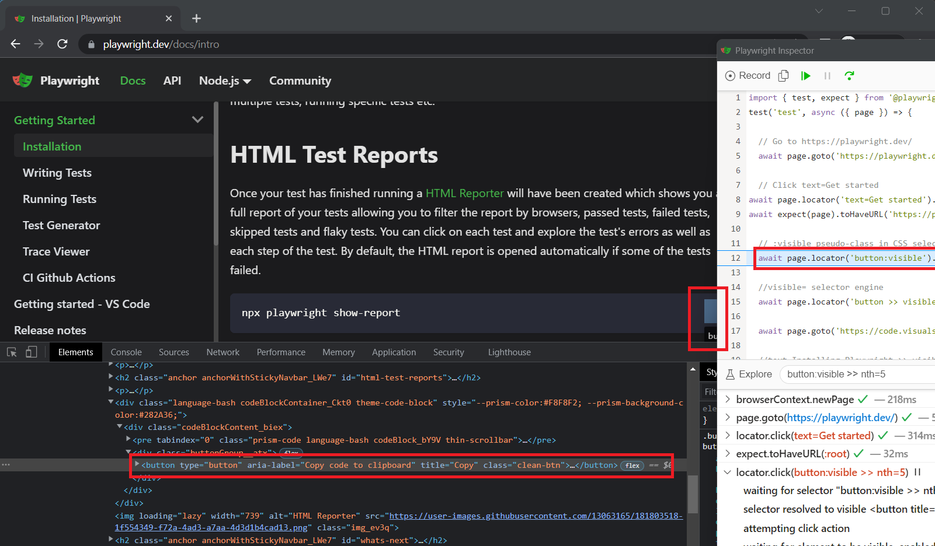
5.7 - Selecting visible elements
:visible pseudo-class in CSS selectors
await page.locator('button:visible').nth(5).click()
visible= selector engine
await page.locator('button >> visible=true').nth(1).click();

Slide 18
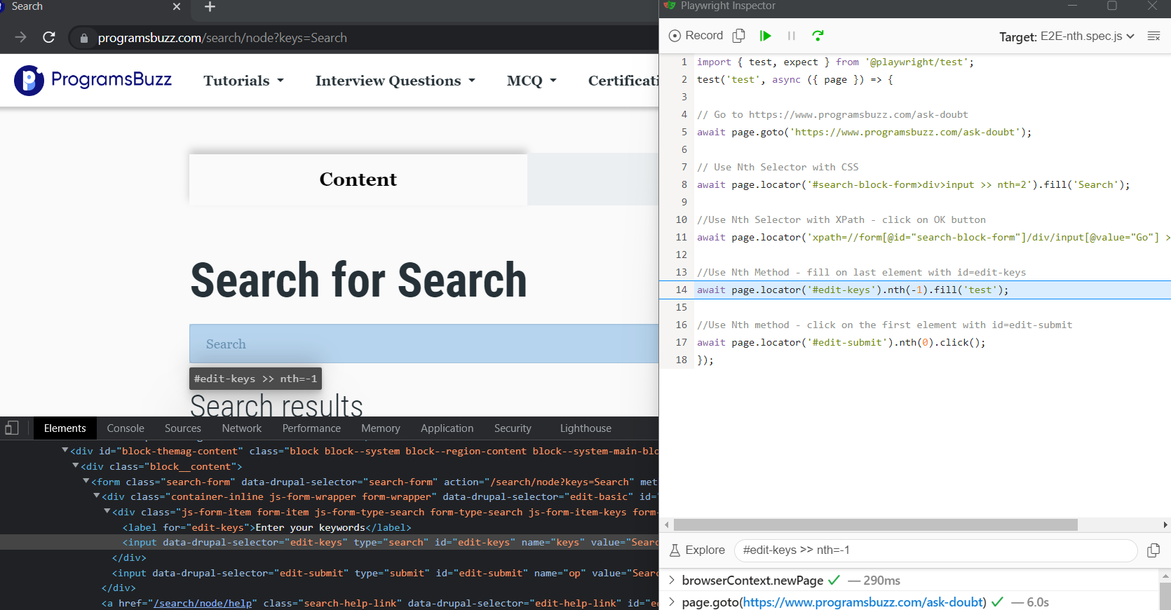
5.8 - Nth Element
Use Nth Selector with CSS
await page.locator('#search-block-form>div>input >> nth=2').fill('Search');
Use Nth Selector with XPath
await page.locator('xpath=//form[@id="search-block-form"]/div/input[@value="Go"] >> nth=1').click();
Use Nth Method
await page.locator('#edit-keys').nth(1).fill('test')

Slide 19
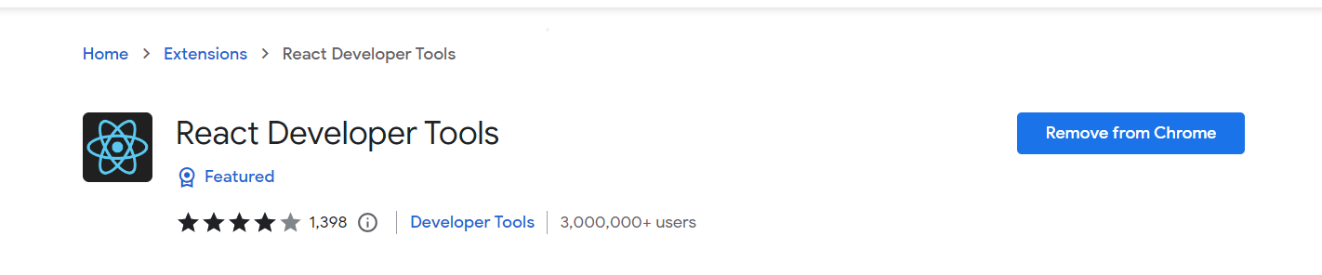
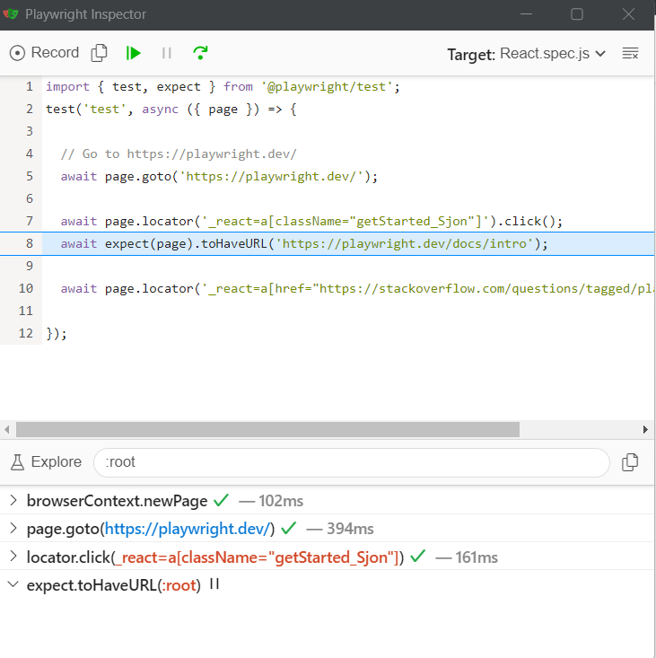
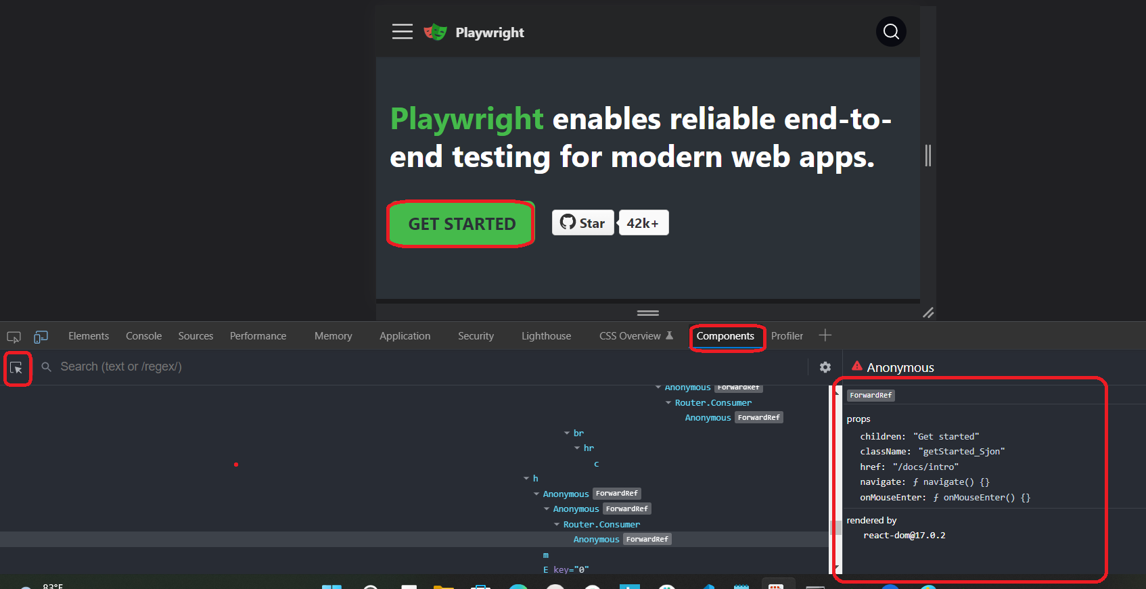
5.9 - React
Preparation: install React Developer Tools on browsers

Slide 20
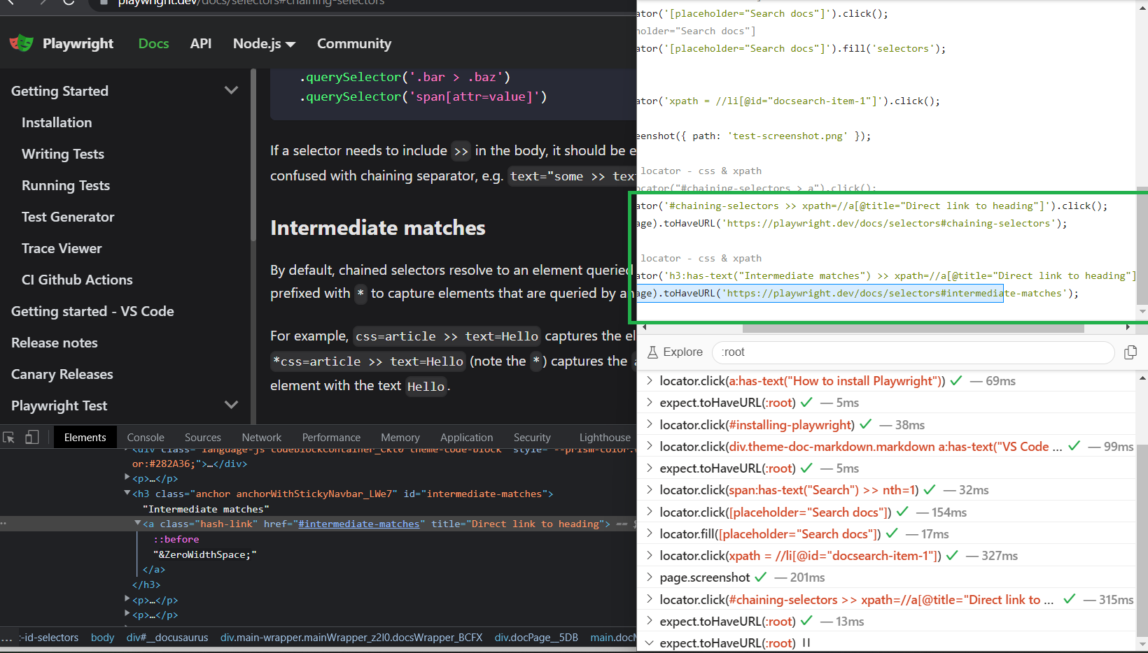
5.10 - Chaining
Syntax - selector1 >> selector2 >> selectors3
Selector can Css, Xpath, Text,...
Use >> token to combine selectors
Limited attribute/ element in DOM > need combine

Slide 21
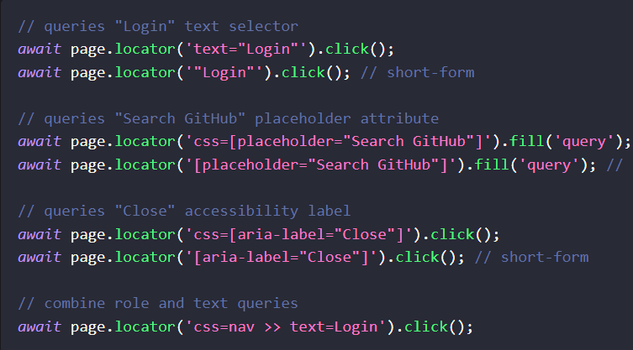
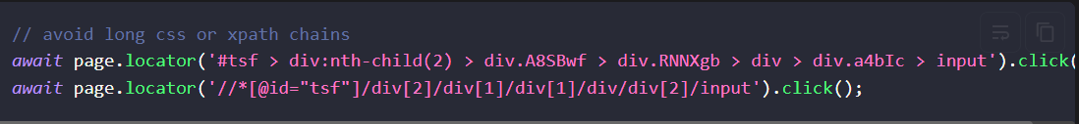
5.11 - Best practices and to avoid choose selector
Prioritize user-facing attributes
Like text content, input placeholder, accessibility roles and labels
These are not impacted by DOM structure changes
Avoid selectors tied to implementation
These selectors can break when the DOM structure changes.
Ex: locator.nth(index), locator.first(), and locator.last()

Slide 22
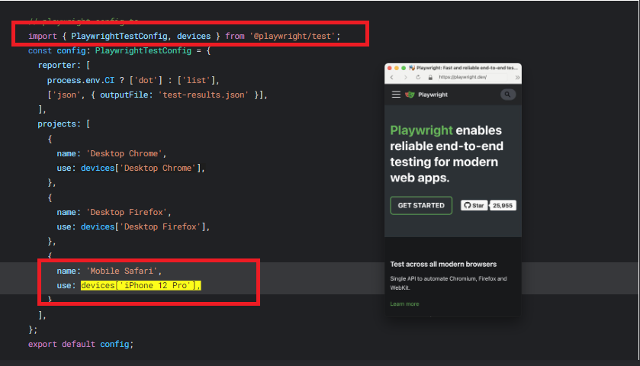
Playwright selector - mobile

Slide 23
2: Weaknesses of Playwright (cont.)
Not support Legacy Microsoft Edge or IE11
Playwright API is not yet available in Java or Ruby
Playwright is new > community limited support

Slide 24
8: Reference documentation
Installation | Playwright
GitHub - microsoft/playwright: Playwright is a framework for Web Testing and Automation. It allows testing Chromium, Firefox and WebKit with a single API.
playwright/selectors.md at main · microsoft/playwright · GitHub

Slide 25


